Slide 1
Climate Change Conference of People In the context of COP-28, Dubai 30th November - 12th December, 2023
Prof. (Dr.) Narasimha Reddy Donthi
Independent Public Policy Campaigner

Slide 2
“Technology Fix” Day
COP28’s Climate Innovation Forum:
exploring cutting-edge solutions including artificial intelligence (AI), satellite technology, big data, clean energy, industrial decarbonization, low-carbon hydrogen
Attendees included:
Bill Gates, Founder of Breakthrough Energy and Co-chair of the Bill and Melinda Gates Foundation.
Arvind Krishna, the CEO of IBM, Kate Brandt, Chief Sustainability Officer of Google.
Elizabeth Gaines, Non-Executive Director and Global Green Ambassador at Fortescue Metals.
Brad Smith, Vice Chair and President at Microsoft
Individuals from several innovative startups from Breakthrough Energy Ventures.
Climate technology can play an important role in accelerating emissions reduction from today's energy, while cleaner sources of supply are expanded.
held talks on a market system of financial incentives to close power plants, in a cost-effective way.

Slide 3
Energy and Industry
Over 60 countries signed the Global Cooling Pledge to cut cooling-related CO2 emissions by at least 68% by 2050.
39 countries commit to boosting the global market for hydrogen energy.
New solutions were presented to finance the uptake of methane emission abatement technologies.
39 global changemakers were recognized for advancing solutions that accelerate the energy transition.
a high-level dialogue focused on electrifying cooking. Globally, household air pollution associated with solid fuel for cooking results in 2.4 million premature deaths each year.
The Global eCooking Coalition is actively advancing electric cooking to boost a just transition to net zero.

Slide 4
Indigenous People’s Day
Indigenous Peoples called on world leaders to protect ancestral land under threat from global warming, mining, oil and gas extraction.
ECUA Indigenous Peoples community called for safeguards for people whose lands bear the brunt of climate change and exploitation of natural resources.
International Union for Conservation of Nature, International Indigenous Forum on Biodiversity, and IUCN Indigenous Peoples Organisations members launched the Podong Indigenous Peoples Initiative.
Mobilization of $200 million from 2023 to 2030 in Biodiversity and Climate finance, with 85% funds reaching Indigenous territories and local communities.

Slide 5
Global Cooling Pledge
The Global Cooling Pledge has been included in the list of nine non-negotiated declarations, pledges, and charters that constitute key outcomes for the COP28 Presidential Action Agenda.
The Pledge intends to raise ambition and international cooperation through global targets for reducing emissions, improving energy efficiency, and increasing access to sustainable cooling for the vulnerable.

Slide 6
Powering Past Coal Alliance
The Powering Past Coal Alliance (PPCA) is a coalition of national and subnational governments, businesses and organisations working to advance the transition from unabated coal power generation to clean energy.
Malta phased out coal power in 1996.
With Malta and the UAE, new PPCA members announced at COP28 up to nine
The PPCA now covers 59 countries
Other members include the US, the Czech Republic, Cyprus, Dominican Republic, Iceland, Kosovo and Norway
Since COP23, this Alliance has been driving momentum to move beyond coal

Slide 7
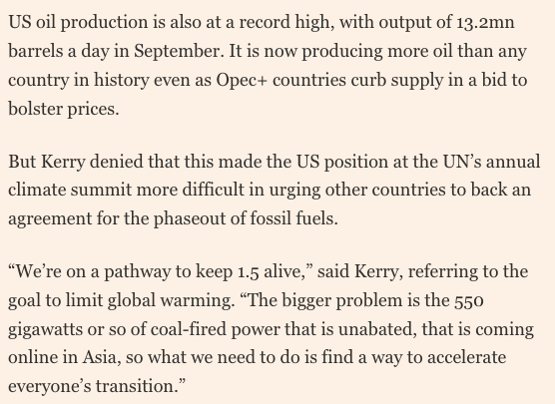
This is what securing national interest looks like in climate negotiations: accelerate everyone’s position, except mine

Slide 8
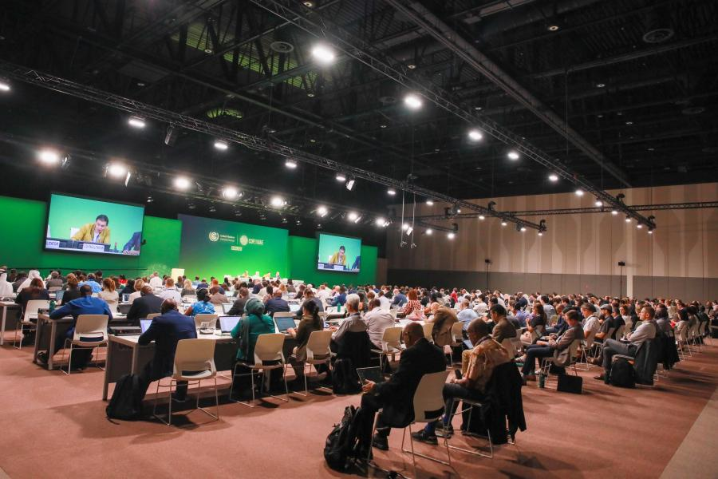
View of the room during informal consultations on rules, modalities and procedures for the Article 6.4 mechanism

Slide 9
Different views: Vignettes
The Director-General of the World Trade Organisation, Dr Ngozi Okonjo-Iweala, has called on delegates at the COP28 climate conference in Dubai to prioritise trade policy in the fight against global warming. Emphasising the need for free and predictable trade, she suggested measures such as adjusting tariffs to promote renewables and revising subsidies for fossil fuels. Okonjo-Iweala also highlighted concerns from less developed WTO members regarding the European Union's carbon border tax, indicating that the WTO is prepared to facilitate dialogue to address potential trade frictions.
“We have to work very hard over the next eight years to move the ratio of power that is generated by coal from the current 36% to less than 4% by 2030. This sounds like a massive and impossible task, but it isn’t.” – Andrew Steer, Chief Executive Officer of Bezos Earth Fund, during the discussion on Enabling a Just and Managed Transition for Coal.

Slide 10
Announcements
UAE joined the Powering Past Coal Alliance, alongside other countries.
Bill Gates' advanced nuclear reactor company TerraPower LLC and the United Arab Emirates’ state owned nuclear company ENEC said on Monday they have agreed to study the potential development of advanced reactors in the UAE and abroad.
The memorandum of understanding comes amid a push by the UAE to expand its nuclear energy capacity, and a pledge by over 20 nations at the COP28 climate conference in Dubai to triple nuclear deployment this decade to fight climate change.

Slide 11
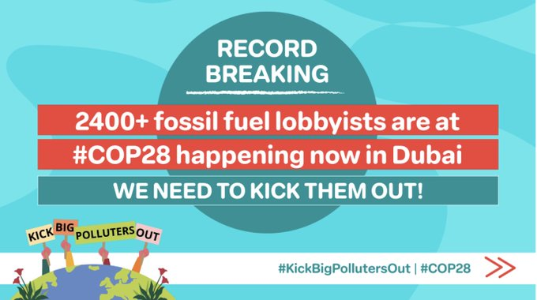
At least 2,456 fossil fuel lobbyists have been granted access. That's a 400% increase since last year.
There are more fossil fuel lobbyists than delegates from the 10 most climate-vulnerable countries combined.
There are more than seven times the number of fossil fuel lobbyists than official Indigenous representatives.
Nine out of 10 the largest hail from the Global North; notably the Geneva-based @IETA
, which brought 116 people, including representatives from Shell and TotalEnergies.

Slide 12
Negotiation tracks
53 draft negotiation texts are under discussion
One negotiator blankly stated “everyone is in the dark” on the process for the second week. Another worried negotiator said once the texts are handed to the Presidency “the process becomes a little bit unclear at that point,”
Energy was a key theme of the negotiations, many of which are struggling to complete draft decisions and conclusions before the Subsidiary Bodies close on Wednesday, 6 December.
Discussions on the just transition pathways work programme proved so divisive that delegates met in informal informal consultations to try landing on a text that can be forwarded to ministers during the second week of the conference.
The same efforts were seen on the Global Stocktake, mitigation work programme, and more.
The task for these negotiators is to prepare a text replete with options that will help ministers negotiate the final COP 28 package.

Slide 13
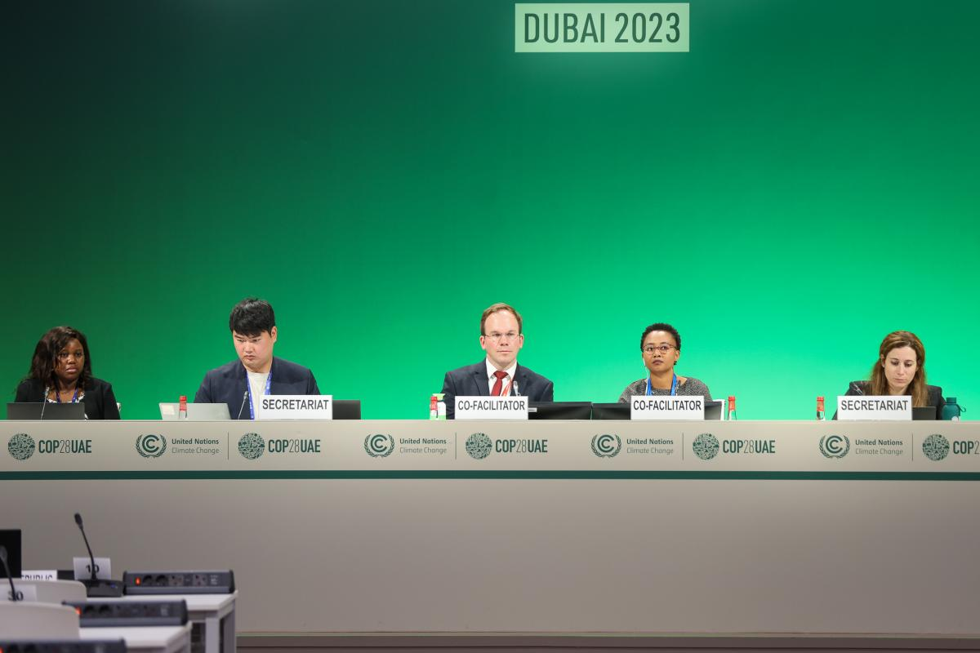
View of the dais during informal consultations on matters relating to Action for Climate Empowerment

Slide 14
Negotiation tracks
53 draft negotiation texts are under discussion
One negotiator blankly stated “everyone is in the dark” on the process for the second week. Another worried negotiator said once the texts are handed to the Presidency “the process becomes a little bit unclear at that point,”
Global stocktake: No bullets but 96 "options" Key section on mitigation, inc FF: Opt1 – "orderly and just phase out of FF" Opt2 – "accel twds phase out unabated FF + rapidly reduce use for net-zero energy by 2050" Opt3 – no txt
USA's edits to the Global Stocktake text include removing references to developed country finance obligation BUT call for more countries "in position" to provide finance. Also suggested removing CBDR in para on improving financial flow

Slide 15
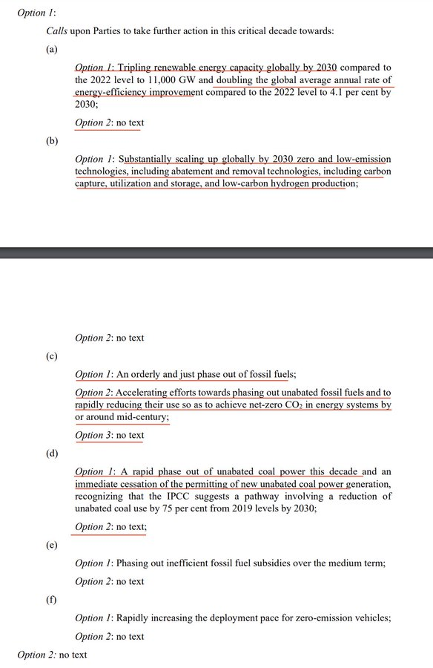

Slide 16
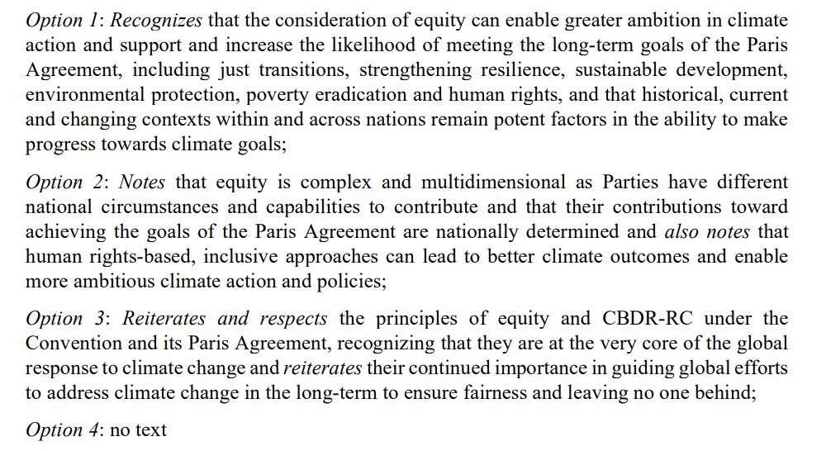
Global stocktake: Options on equity

Slide 17
Studies and Reports
New study finds that planted forests with mixed tree species stored 70% more carbon than single-species forests, making them better at capturing carbon from the atmosphere.
“As momentum for tree planting grows, our study highlights that mixed species plantations would increase carbon storage alongside other benefits of diversifying planted forests,” said Dr Susan Cook-Patton, a senior forest restoration scientist at The Nature Conservancy and collaborator on the study.

Slide 18
Studies and Reports
The Global Cooling Watch report, Keeping it Chill: How to meet cooling demands while cutting emissions – by the UN Environment Programme-led Cool Coalition – lays out sustainable cooling measures in three areas: passive cooling, higher-energy efficiency standards, and a faster phase down of climate-warming refrigerants.
Taking key measures to reduce the power consumption of cooling equipment would cut at least 60 per cent off predicted 2050 sectoral emissions, provide universal access to life-saving cooling, take the pressure off energy grids and save trillions of dollars by 2050

Slide 19
Tidbits
Organisers of Cop28 and the UN body overseeing the annual climate conference have not clarified whether activists in Dubai are safe to demonstrate, risking civil society in a country where protests are generally prohibited.
Despite 80,000 attendees, including activists, some protests have been denied permission, raising concerns about safety given the UAE's restrictions on free expression. Critics argue that hosting Cop28 in such an environment poses risks and that safety assurances should not be necessary.
Speaking at a UNFCCC COP 28 side event in Dubai, Leena Nandan (Environment Secretary, India) highlighted India's success in decoupling emissions from economic growth. “India has continued to grow, it has also progressively decoupled emissions from economic growth, and this has resulted in achievement of 33% reduction in emission intensity of GDP in 2019 itself," she said.

Slide 20
COP28 Programmes
There will be no thematic events on final two days of COP28, to focus on negotiating texts
There are 95 events scheduled for this day
A Ministerial Meeting on Urbanisation and Climate Change on 6th December
Parliaments Driving Climate Action and Sustainability beyond the first Global Stocktake
A convening of over 140 national parliamentary bodies to discuss parliamentarian role in climate action, organized by IPU

Slide 21
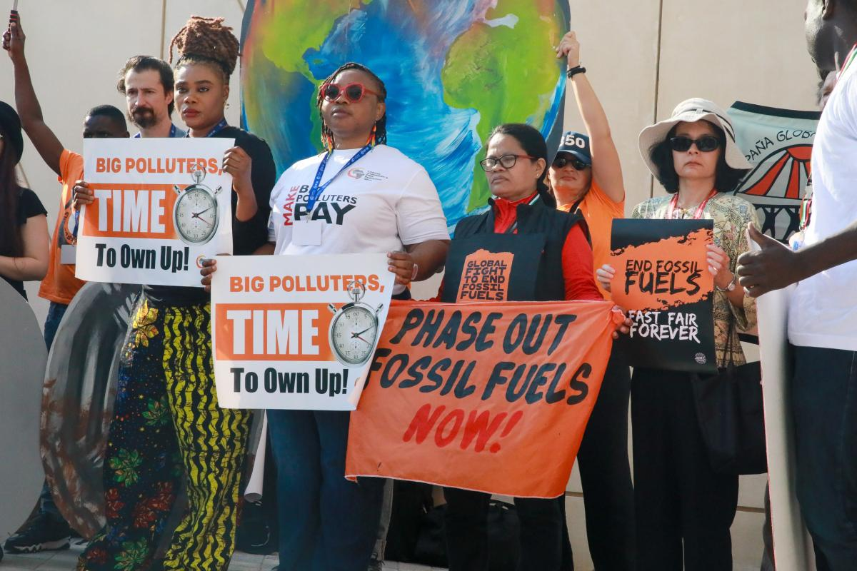

Slide 22
