Slide 1
Climate Change Conference of People In the context of COP-28, Dubai 30th November - 12th December, 2023
Prof. (Dr.) Narasimha Reddy Donthi
Independent Public Policy Campaigner

Slide 2
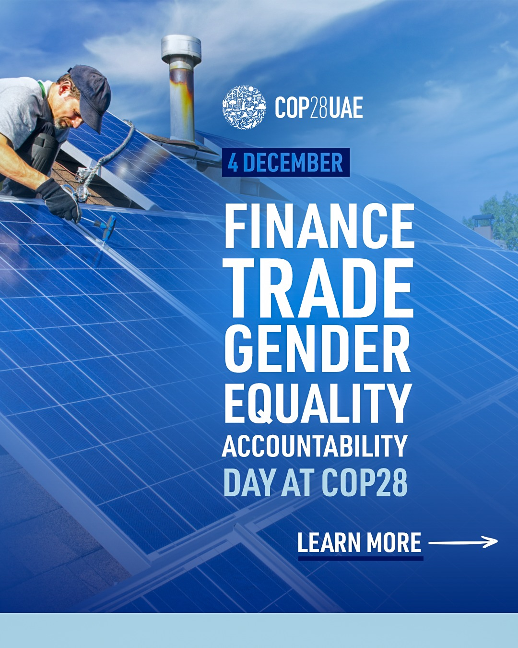

Slide 3
Finance Day
The UK, France, World Bank, Inter-American Development Bank (IDB), European Investment Bank (EIB), European Bank for Reconstruction and Development (EBRD) and African Development Bank (AfDB) made new commitments to expand CRDCs in their lending.
climate-resilient debt clauses (CRDCs) allow debt service to be paused to provide breathing space when countries are hit by climate catastrophes.
In total 73 countries called on donors to expand the use of these clauses by 2025.
credit rating agencies such as Fitch Ratings, indicated their intention to consider revisions to credit rating criteria for loans to ensure use of CRDCs does not impose a burden for borrower countries.

Slide 4
Finance Day
COP28 UAE Declaration on a Global Climate Finance Framework
The Declaration is endorsed by India, France, Barbados, Kenya, Ghana, Germany, UK, USA, Senegal, and Colombia.
It lays out defining principles for a climate finance architecture that delivers for all.

Slide 5
Different views: Vignettes
Finance is the great enabler for climate action, Simon Steill, Executive Secretary of UNFCCC
Falling in love with the ocean is the first step to protecting it! (Maya Gabeira)
“The science has shown that the women are the most affected by climate change and women are the biggest percentage of humanity. It means that we hold half of humanity. And we are the most affected by climate change.” (Jeanne d'Arc Mujawamariya)
HUMANS are HUMANS. I am sick and tired of my gender being the rally cry for everything your lot wants to promote using emotional blackmail. (unknown)

Slide 6
Announcements
Razan Al Mubarak has announced the launch of the COP28 Gender-Responsive Just Transitions & Climate Action Partnership to mainstream gender in the implementation of the Paris Agreement.
The partnership, endorsed by 60+ countries, aims to support equal opportunities for decent work in emerging job markets, enable finance flows to women and girls in climate-impacted regions, and supports the call for gender-disaggregated data collection.
WTO Focus on shipping and logistics at #TradeHouseCOP28: Decarbonizing the sector has become a global imperative as the backbone for international trade.

Slide 7
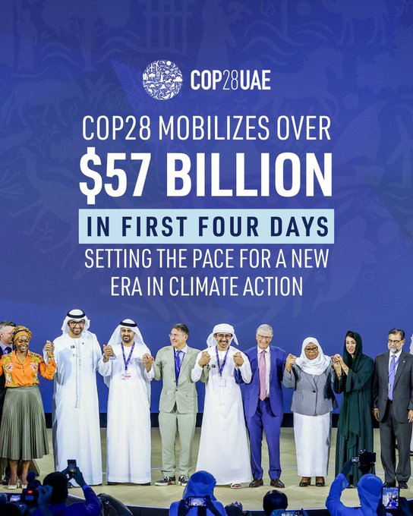
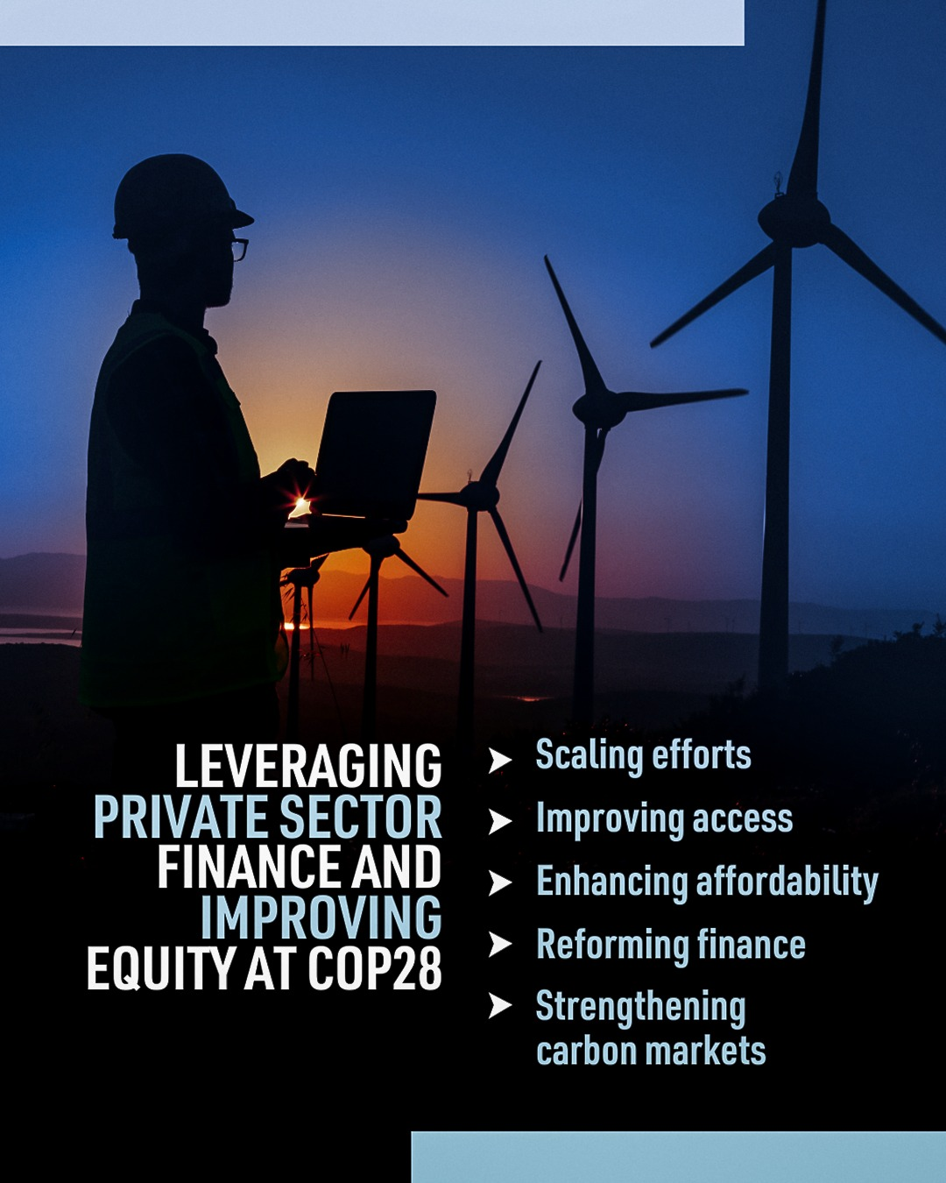

Slide 8
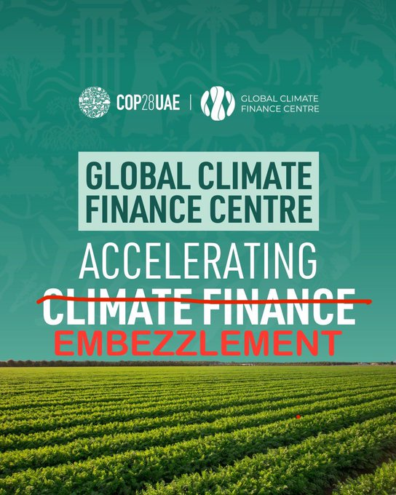

Slide 9
High level Events
Three High-Level events (on Adaptation, Means of Implementation and Mitigation respectively) were held:
on the 1st and 2nd December 2023, chaired by the first global stocktake (GST) High-Level Committee (HLC), consisting of the COP 27 and COP 28 Presidencies of the CMA, and the Chairs of the Subsidiary Body for Scientific and Technological Advice (SBSTA) and the Subsidiary Body for Implementation (SBI).
The events were facilitated by the UN Climate Change High-Level Champions of the COP26, COP27 and COP28 Presidencies.
A total of 29 Heads of State and Government, 21 ministers, 10 high-level officials, 3 United Nations system organizations and 8 non-governmental organizations (NGOs) provided interventions.
Message: we are still off track.
There is an urgent need for a paradigm shift, taking a holistic approach

Slide 10
Snapshot Day 5
UAE banks commit USD 272 billion in sustainable finance
Multilateral Development Banks (MDBs) unlock vital climate finance
Abu Dhabi Global Market launch Global Climate Finance Centre
Operationalizing the Declaration Framework

Slide 11
Voluntary carbon markets
6 major Carbon crediting programs announced collaboration
signed a joint statement to amplify the impact of carbon markets.
Voluntary Carbon Markets Initiative
GHG Protocol
We Mean Business coalition
Science based Targets Initiative
CDP
N

Slide 13
Negotiation tracks
53 draft negotiation texts are under discussion
Glasgow–Sharm el-Sheikh Work Programme on the Global Goal on Adaptation: Numerous groups and parties expressed serious concerns with the draft. They noted multiple submissions were not reflected, considered the text imbalanced, unacceptable, and unworkable. The Co-Facilitators will produce new text, but warned that this might bring the group farther away from achieving an outcome at COP 28. Informal consultations will continue.
With only two days left before the Subsidiary Bodies close, negotiators tried to catch up on several issues. Many seemed to progress slowly.
Many of the trickiest issues, mostly under the COP and/or CMA, also struggled to find common ground among parties. Several new texts were large, unedited compilations of views. The accusatory phrase “my way or the highway” was heard across rooms.
Progress on finance issues soured, especially the Standing Committee on Finance

Slide 14
Studies and Reports
Global Carbon Budget Report 2023
Global fossil CO₂ emissions (including cement carbonation) are expected to further increase in 2023, to 1.4 % above their pre-COVID-19 pandemic 2019 level.
fossil emissions in 2023 are expected
to decrease by 7.4 % in the European Union
by 3.0 % in the United States
increase by 4.0 % in China
Increase by 8.2 % in India

Slide 15
Studies and Reports
Emissions from coal, oil, and gas in 2023 are all expected to be slightly above their 2022 levels (by 1.1 %, 1.5 %, and 0.5 %, respectively).
Fossil CO₂ emissions decreased in 18 countries during the decade 2013–2022.
These 18 have contributed about 1.9 Gt C yr⁻¹ (7.1 Gt CO₂) to fossil fuel CO₂ emissions over the last decade, representing about 20 % of world CO₂ fossil emissions.
The concentration of CO₂ in the atmosphere is set to reach 419.3 parts per million (ppm) in 2023, 51 % above pre-industrial levels.
The Global Carbon Budget report, produced by an international team of more than 120 scientists, provides an annual, peer-reviewed update, building on established methodologies in a fully transparent manner.

Slide 16
Tidbits
On 1 and 2 December, 154 Heads of States and Government, and 22 International Leaders gathered for the World Climate Action Summit (WCAS)
More than 500 mayors, governors and other local leaders participated in WCAS
Over 850 businesses and philanthropic participated in the Business and Philanthropy Forum and announced $5BN in new funding
Over 200 Small and Medium sized Enterprises too
137 Heads of State signed COP28 UAE Declaration on Sustainable Agriculture, Resilient Food Systems, and Climate Action, with financing commitments totaling $2.6BN
125 countries endorsed the COP28 UAE Declaration on Climate and Health, and finance is $1BN
119 countries endorsing the Global Renewables and Energy Efficiency Pledge
Oil and Gas Decarbonization Charter (OGDC) saw 51 companies, including 29 national oil companies, support its target to reach net zero emissions by 2050 or before, with 30 committing to near zero methane emissions for the first time.
COP28 presidency held a roundtable discussion focused on accountability and regulatory frameworks necessary for a sustainable and equitable Net-Zero transition.

