Slide 1
Climate Change Conference of People In the context of COP-28, Dubai 30th November - 12th December, 2023
Prof. (Dr.) Narasimha Reddy Donthi
Independent Public Policy Campaigner

Slide 2
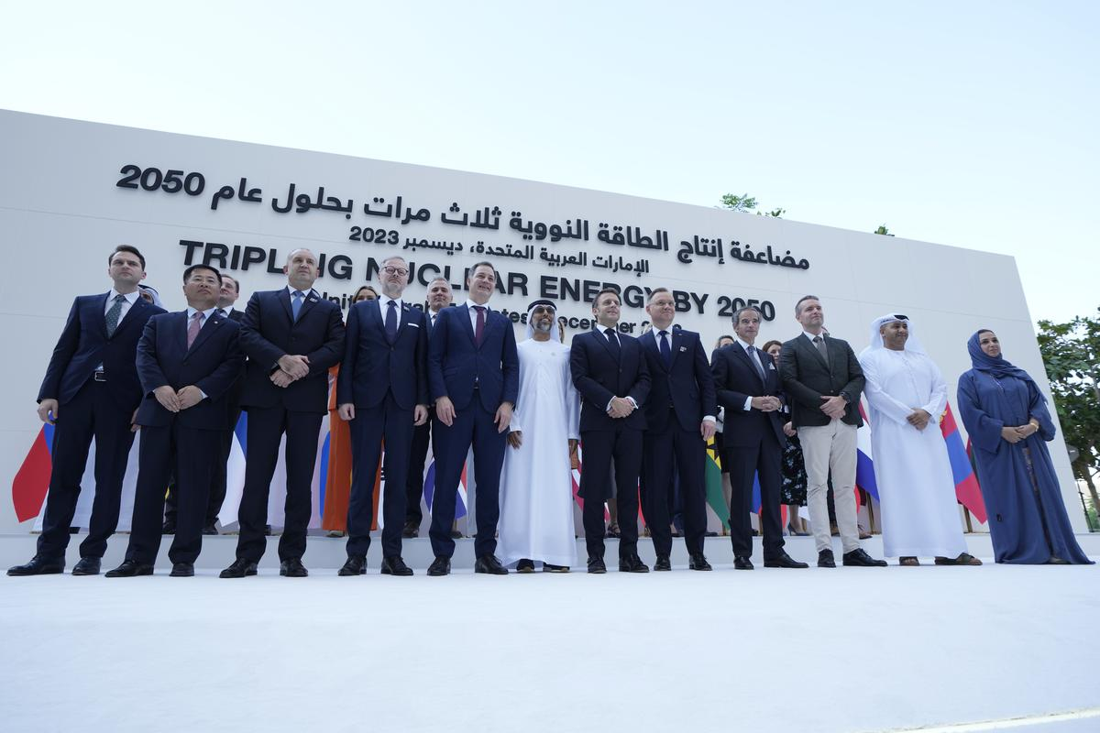

Slide 3
World Climate Action Summit

Slide 4
Methane Summit
United States, People’s Republic of China, and United Arab Emirates
accelerate actions to cut methane and other non-CO2 greenhouse gases
over $1 billion in new grant funding for methane reduction mobilized since COP27
Turkmenistan, Kazakhstan, Angola, Kenya, and Romania joined the Global Methane Pledge.
Global Methane Pledge Ministerial on December 4
The World Bank is expected during the two-week COP28 summit to new launch a fund, with backing from independent oil companies among others, for detection and cleanup programs in developing countries that are major methane emitters, such as Turkmenistan
more than 150 countries to cut their methane output 30% by 2030 (China and India have not joined)

Slide 5
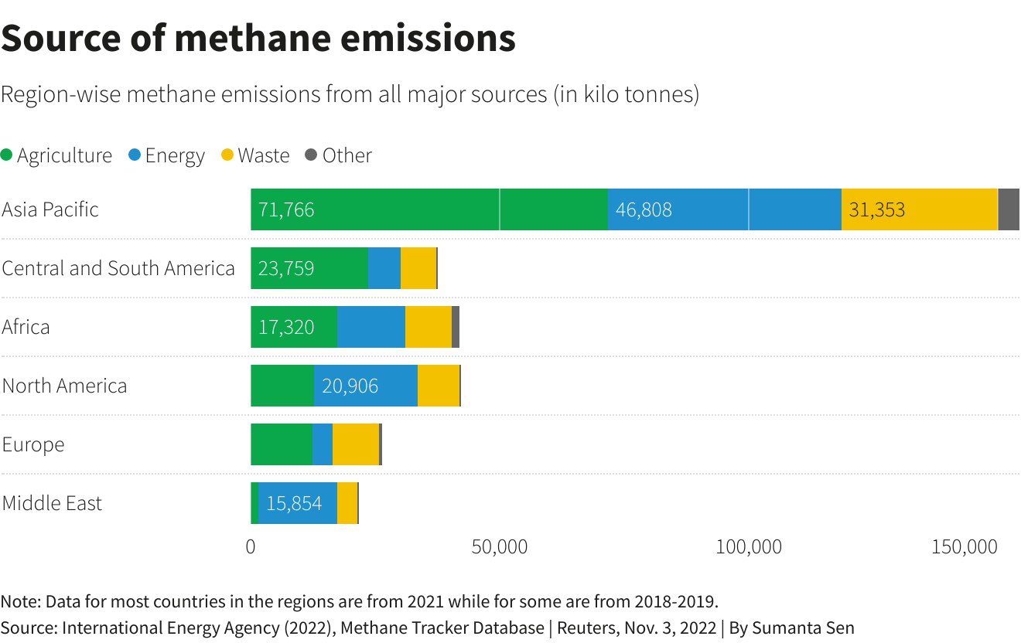

Slide 6
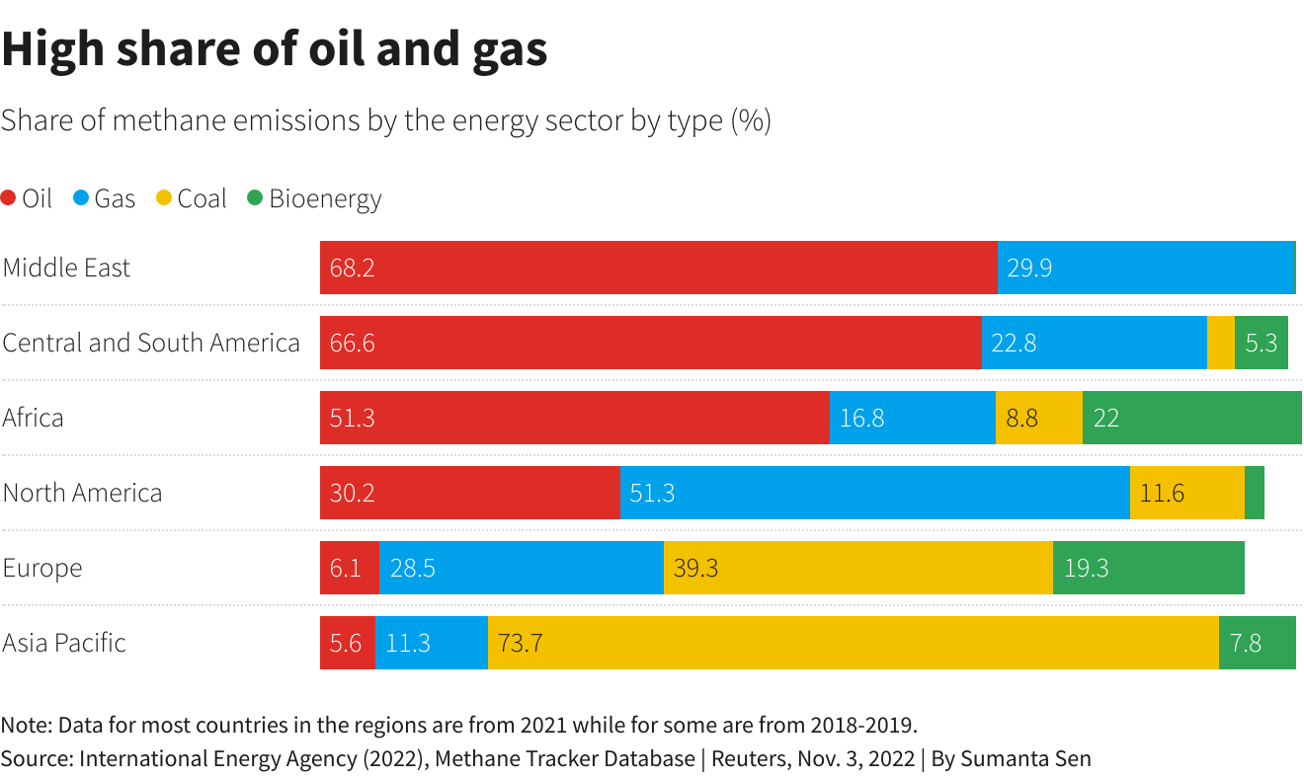

Slide 7
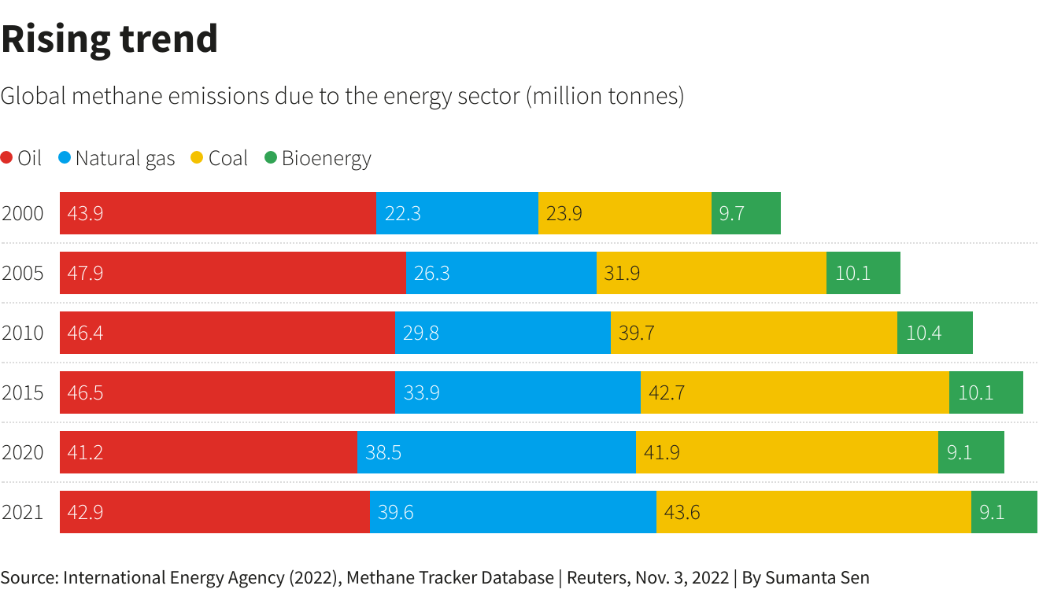

Slide 8
Fossil fuel
Fifty oil companies representing nearly half of global production have pledged to reach near-zero methane emissions and end routine flaring in their operations by 2030
Major national oil companies such as Saudi Aramco, Brazil's Petrobras and Sonangol, from Angola, and multi-nationals like Shell, TotalEnergies and BP.
10 countries and 2,234 CSOs signed call for fossil fuel non-proliferation treaty

Slide 9
Side Events
14 side events involving business, technology and entrepreneurship
CEO-level Business & Philanthropy Climate Forum (BPCF) met for the Private Sector, to expedite climate and nature action.
Technology for Climate: Meeting on AI involving Google and Microsoft, to harness AI to confront environmental challenges and drive sustainability
The Green Zone Day Pass not available for first three days, from 30 November to 2 December. During this time, access to the Green Zone is by invitation-only.

Slide 10
Announcements
118 countries have agreed to triple installed global renewable energy generation capacity to at least 11,000 gigawatts and to double the annual global average rate of energy efficiency improvements from ~2 percent to more than 4 percent every year until 2030 (India is not in this list)
United States is joining the Powering Past Coal Alliance. US will work with partners around the world to phase out unabated coal
US announced an additional $50 million, subject to congressional approval, for climate-related work to adapt crops and invest in fertile, healthy soils.
A first-of-its-kind nuclear energy summit, to be held in Brussels in March 2024 to highlight the role of nuclear energy in addressing the global challenges to reduce the use of fossil fuels, enhance energy security and boost economic development.
Fifty oil and gas companies have signed a “decarbonisation charter” that analysts have criticised for ignoring the emissions spewed when customers burn the fuels.
Colombia, a major fossil fuel producer, has formally joined an alliance of nations calling for a fossil fuel non-proliferation treaty to prevent the “omnicide of planet Earth”.

Slide 11
Tidbits
United Arab Emirates announced their intention to ratify the Kigali Amendment to the Montreal Protocol, to tackles HFCs.
Governments reiterated their recent agreement to the largest ever replenishment of the Montreal Multilateral Fund with $965 million in funding to support Kigali Amendment implementation and energy efficiency.
Governments welcomed the imminent launch of the Global Cooling Pledge, to reduce global cooling-related emissions by 2030.
More than 20 nations including the United States called for a tripling of nuclear energy to drive down emissions

Slide 12
Different views: Vignettes
The flurry of announcements coming out of COP28 are largely to be welcomed. It's good to see countries, & companies, taking voluntary action to cut emissions, boost renewables & deliver more climate finance. But, we need to remember COP28 is not a trade show & a press conference. It’s an international negotiation & that is still the most important part. (Mohammad Adow)
Sadhguru says soil is ultimate unifier, stresses on revitalisation policies
For the Global good, it is important that the rights of everyone are protected, and everyone has equal participation: PM Modi
Developed countries should reduce completely reduce carbon foot print by 2050: Modi

Slide 13
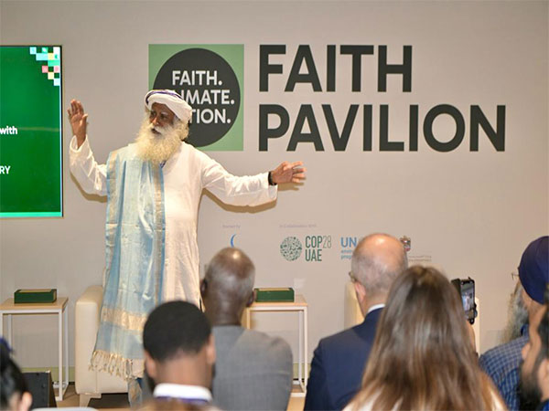

Slide 15
Climate and Health
‘COP28 UAE Declaration on Climate and Health’ to place health at the heart of climate action and accelerate the development of climate-resilient, sustainable and equitable health systems.
123 countries endorsed
Health Ministers attending COP, along with Environment Ministers
The Asian Development Bank: new Climate and Health Initiative, initial allocation of $7 million
Wellcome Trust, Rockefeller Foundation, Bloomberg Philanthropies, AVPN and Bayer Foundation, Foundation S, etc.

Slide 16
Climate and Health
Bill & Melinda Gates Foundation announced $57.95 million towards climate and health. This includes a $50 million investment over the coming four years to support climate-focused malaria efforts to better understand, detect and respond to changing vector habitat and endemicity ranges, and to develop new tools and strategies to respond to climate-related changes and disruptions in the malaria response. In addition, the Foundation will contribute $7.95 million to a Grand Challenges Request for Proposal focused on transdisciplinary approaches to better adapt to, mitigate, or reverse the combined deleterious effects of climate change on health and agriculture.

Slide 17
New areas of concern

Slide 18
Negotiation tracks
Sharm el-Sheikh Mitigation Ambition and Implementation Work Programme: Prepared a note, but consultations proceeded without reference to it
Guidance on Paris Agreement Article 6.4 (mechanism): Discussion on annual report of the Article 6.4 Supervisory Body (FCCC/PA/CMA/2023/15 and Add.1). It contains recommendations to the CMA on: establishment of a Designated National Authorities Forum; exemption for activities in LDCs from payment of the share of proceeds for adaptation; activities involving removals; and development and assessment of methodologies.
Matters Relating to Article 6: Guidance on Paris Agreement Article 6.2 (cooperative approaches): Define and operationalize ‘cooperative approaches’

Slide 19
Negotiation tracks
Glasgow–Sharm el-Sheikh Work Programme on the Global Goal on Adaptation: Views diverged on: whether to include as an element the principles of the Convention and Paris Agreement, particularly equity and common but differentiated responsibilities and respective capabilities (CBDR-RC); and having a new standalone agenda item on the GGA under both SBs.
Report and review of the Adaptation Committee (AC): Co-Facilitators Pilar Bueno (Argentina) and Roberta Ianna (Italy) proposed that the first informal consultations focus on reviewing the 2023 AC report.
National Adaptation Plans (NAPs): Proposals included: recognizing new NAP submissions and highlighting progress; emphasizing the importance of financial, technical, and capacity-building support for NAP formulation and implementation; participatory approaches that engage local stakeholders and integrate Indigenous and local knowledge; and adding links to the GST and GGA.

Slide 20
Negotiation tracks
Standing Committee on Finance (SCF): Proposed to address matters related to Paris Agreement Article 2.1(c) (on making financial flows consistent with a pathway towards low GHG emissions and climate-resilient development), followed by the doubling of adaptation finance and urgently scaling up support
Matters relating to the Adaptation Fund: Parties’ comments related to, among others: concerns over multi-country projects; enhanced complementarity and coordination with the GCF, including on accrediting implementing agencies; and calls for enhanced contributions to the Fund, with LDCs noting the share of proceeds from the Clean Development Mechanism is negligible.
First Global Stocktake: reference to maladaptation opposed, clarity asked for, suggesting it could prove a barrier to finance.
calls on human rights, Indigenous rights, gender, and youth from several countries. References to locally-led adaptation, national- and transnational-level action and inclusive adaptation processes.

Slide 21
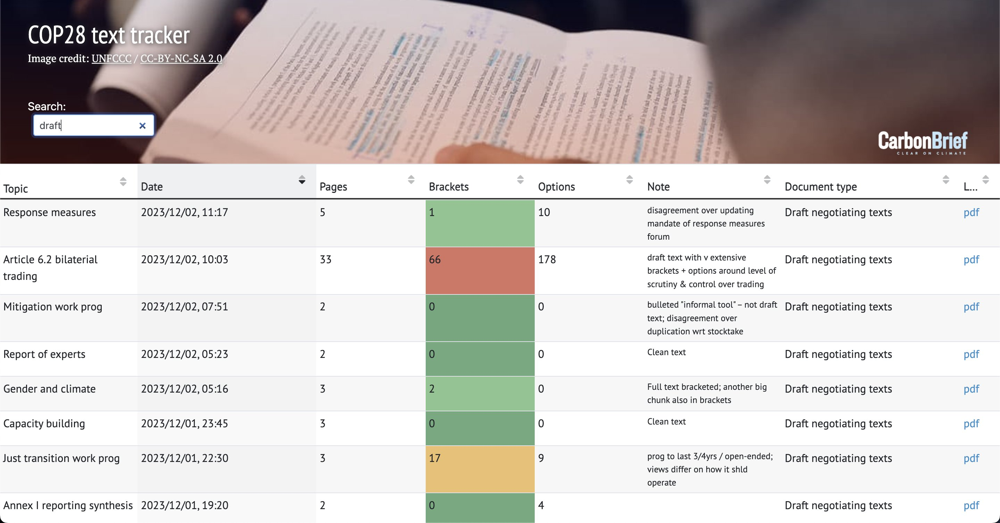

Slide 22
India
R. K. Singh, at the conference on ‘Energy Transition in India – Road Travelled and Opportunities Ahead’ in Gandhinagar, Gujarat.
India has the potential to generate upto 100 Giga Watts of power using nuclear source
“We bid for a storage capacity of 1,000 MWh – the biggest bid in the world – at ₹10 per kWh. However, this cost of storing one unit for one hour at ₹10 raised concerns, considering the cost of power generation from renewable sources is ₹2.40 per unit. Selling this stored energy at ₹14 per unit to customers is not feasible, making it crucial to address the storage issue before we can provide round-the-clock renewable energy,” according to Singh.
“We burn coal, but our emissions are controlled due to advanced mechanisms. Our consumption is lower than other countries, and we must consider coal or nuclear as solutions until the storage challenge is resolved,” he said.

Slide 23
India
“Our emission intensity is 2.19 tonnes per capita per annum which is one of the lowest in the world, while global average is 6.8 tonnes. We are the only country which has achieved our NDCs (nationally determined contributions) nine years in advance.
We had pledged that by 2030, 40% of the country’ energy generation will be through non-fossil fuels. This target has been achieved before time as the country’s non-fossil fuel capacity at present stands at 43%,” Singh said.
The minister dismissed the phasing out of coal power plants by India as a “diversionary tactic topic” promoted by “anti-development forces,” highlighting that the country has one of the world’s lowest per capita emissions.
“We have 7,000 MW of installed nuclear capacity, and we are expanding it to 15,000 MW. We have the capability to further increase it to 50-60 GW or even 100 GW for sustained round-the-clock clean energy generation.”

Slide 24
Studies and Reports

Slide 25
Conference Asides
Long queues
there were delays and postponements to several negotiation items, “the traditional aspects of a COP,” in the words of a long-time negotiator.
This is the biggest COP yet, with 103,000 people registered and roughly half of those already holding their badges.
Several rooms were beyond capacity, prompting Co-Facilitators to ask observers and even party delegates to limit their numbers and leave, if possible.

Slide 27
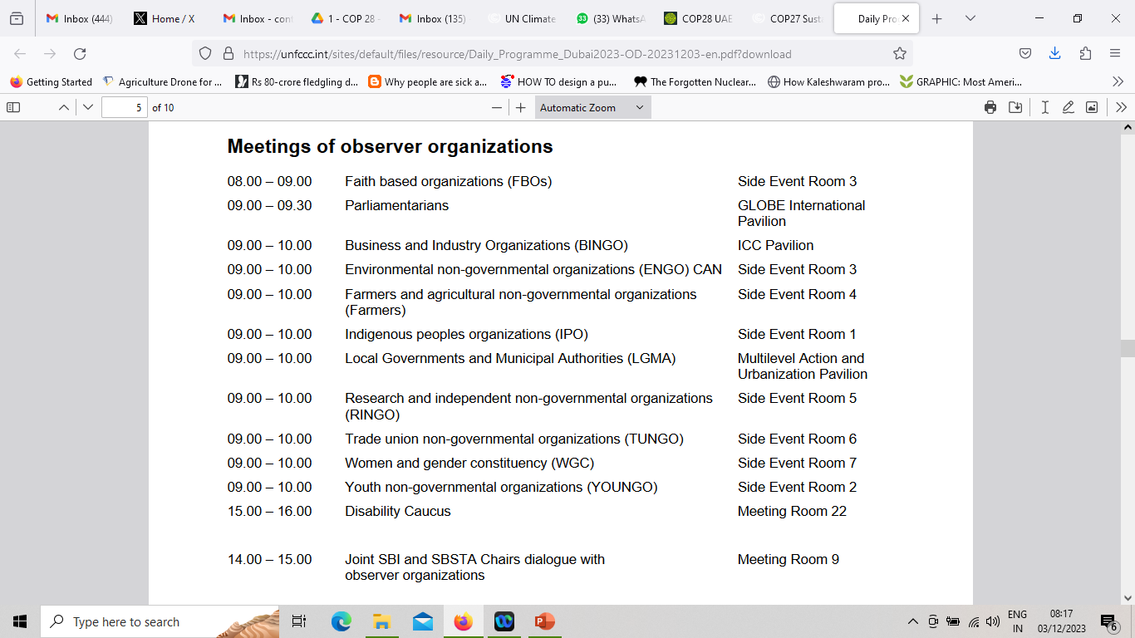

Slide 28
