Slide 1
Climate Change Conference of People In the context of COP-28, Dubai 30th November - 12th December, 2023
Prof. (Dr.) Narasimha Reddy Donthi
Independent Public Policy Campaigner

Slide 2
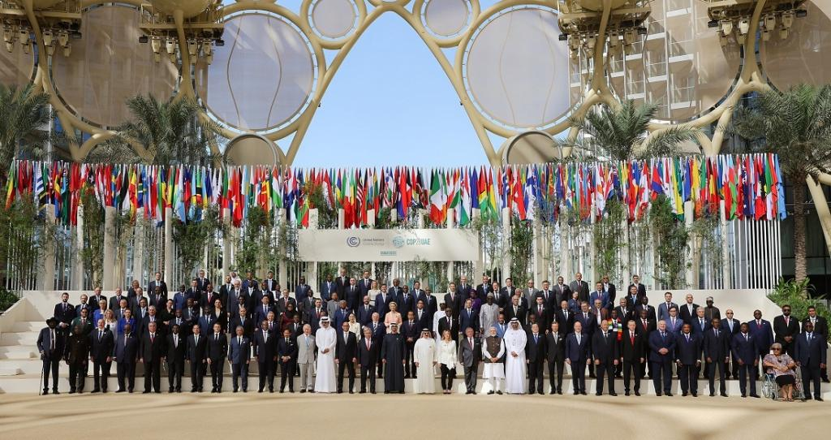

Slide 3
World Climate Action Summit
141 heads of state are listed for speaking in this Summit

Slide 4
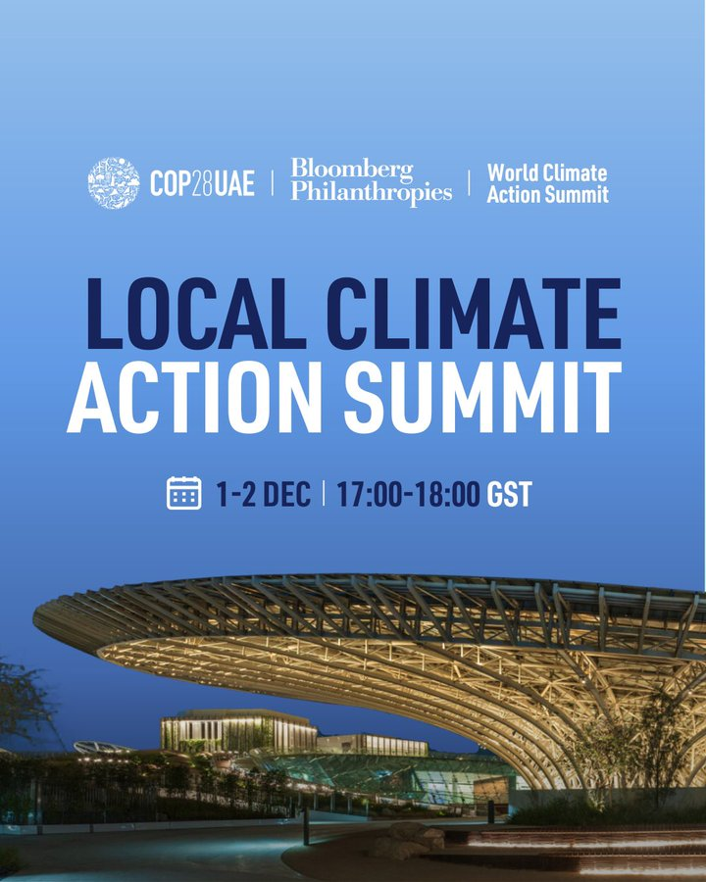

Slide 5
Local Climate Action Summit
The first-ever such Summit hosted by a COP Presidency to bring subnational leaders into the climate action table and advocate directly for the funding, authority, and support from national governments
UN SG: Local leaders are often going further and faster than their national governments to tackle the climate crisis.
call on local leaders to develop comprehensive and detailed transition plans
local leaders to demand a seat at the table as national governments develop climate policies and regulations

Slide 6
Food transformation
Over 150 Non-State Actors sign Call to Action calling for transformation of food systems for people, nature and climate
Transform food and agriculture
prioritises integrated food systems approaches
solutions that will deliver the most impact in the shortest time combine the issues of climate, nature, and food and nutrition security, delivering multiple benefits to multiple stakeholders
The Bezos Earth Fund has committed US$1bn by 2030 to support food systems transformation to tackle the dual threats of climate change and biodiversity loss, whilst delivering healthy food to a growing population

Slide 7
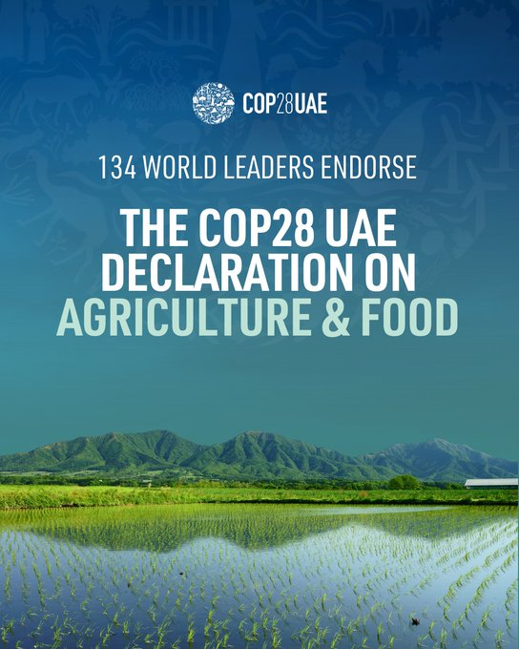

Slide 8
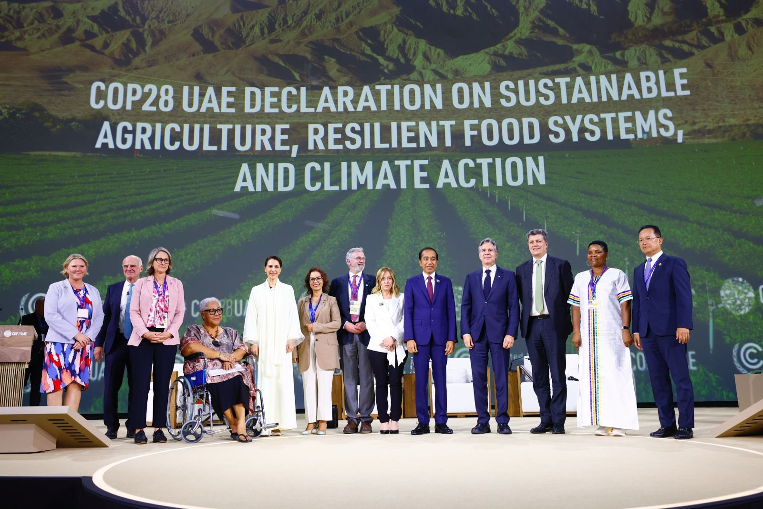

Slide 9
Food transformation
Launched at COP28 in Dubai, the Emirates Declaration on Sustainable Agriculture, Resilient Food Systems and Climate Action reaffirms existing international commitments to halt climate change and nature loss while building in more resilience. It outlines how bringing these agendas together will be crucial to ensuring food security in the decades to come.
134 countries are part of this Declaration
mobilisation of more than $2.5 billion in funding to support food security while combatting climate change
new partnership between the UAE and the Bill and Melinda Gates Foundation for food systems innovation
Comment: makes no reference to fossil fuels-at least 15% of fossil fuels burned each year on food sector—equivalent to the emissions of all EU countries and Russia combined.
Comment: plans to boost global trading systems through the World Trade Organization are only going to benefit industrial giants and not farmers
10 December: High-level Session will convene dignitaries and ministerial leadership around the Emirates Declaration to discuss the paths, modalities, and opportunities involved in its implementation.

Slide 10
Comments on both Food Declarations
No legally binding commitments
Language remains very vague
Specific actions and measurable targets are missing
Zero reference to industrial farming contribution to carbon emissions

Slide 11
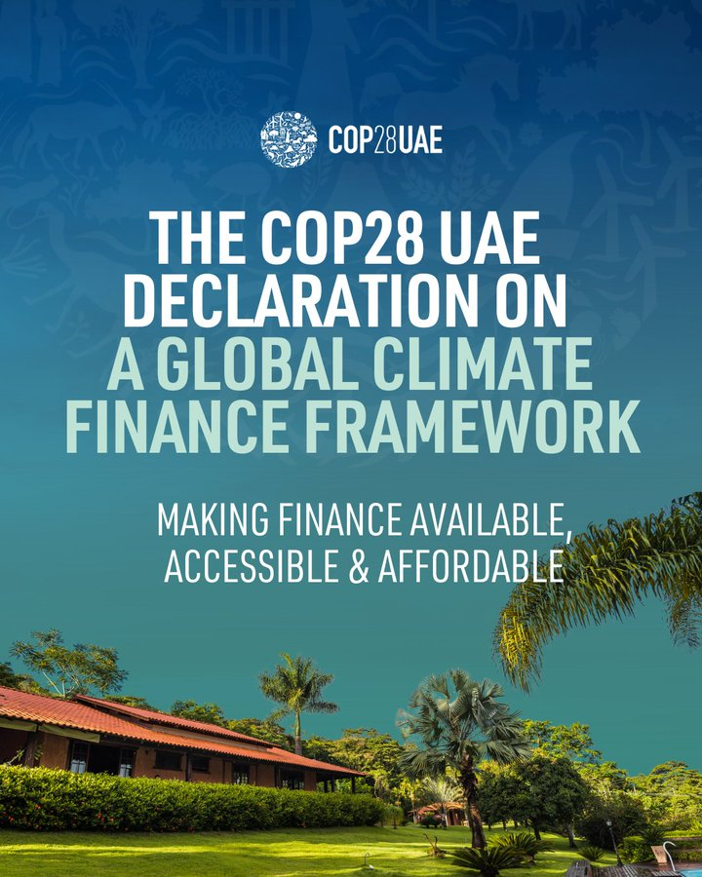

Slide 12
Side Events
CEO-level Business & Philanthropy Climate Forum (BPCF) met for the Private Sector, to expedite climate and nature action.
Technology for Climate: Meeting on AI involving Google and Microsoft, to harness AI to confront environmental challenges and drive sustainability

Slide 13
Tidbits
Dr. Al Jaber launched COP28 UAE Declaration on a Global Climate Finance Framework (The Declaration) in response to Global Stocktake and to keep 1.5°C within reach and to meet goals of Paris Agreement
focusing on: rebuilding trust, reframing climate investments are economic opportunities and scaling up climate finance
The UAE is pledging $200 million USD to the IMF Resilience and Sustainability Trust.
Action Agenda on Regenerative Landscapes - transitioning 160 million hectares to regenerative agriculture by 2030, accompanied by USD$2.2 billion in future investment, and engaging 3.6 million farmers world-wide.
USD 30 billion fund that will foster transformative international partnerships towards achieving global climate solutions

Slide 14
Different views: Vignettes
Addressing climate change requires a united effort, and the Global Stocktake ensures we stay on course." - Angela Merkel
Dr Aditi Mukherji, director, CGIAR’s climate change adaptation and mitigation action platform: Science and evidence-based innovations can be the fuel that drives forward the transformation needed across food systems but this needs adequate funding and integration into policymaking to achieve impact at scale.
Professor Appolinaire Djkeng, director-general, International Livestock Research Institute: “Empowering developing countries to sustainably increase the productivity of livestock offers the opportunity to achieve climate goals while also improving food, nutrition and income security.”
Diego Martinez Schuett, food systems advisor, CAFOD: This Declaration will only work if it encourages governments to focus on strengthening local food systems through solutions that have already proven effective, such as agroecology.”
In fact, the UAE imports more than 80 per cent of its food, and the GCC region imports more food per capita than anywhere else in the world. (Unknown)

Slide 15
New areas of concern
Industrial farming which contributes to 15 percent of fossil fuel burning
Lack of reference to the industry fossil fuel dependence is glaring
According to a new analysis by the International Institute for Sustainable Development (IISD), governments globally issued more than $1.7 trillion in public money to support fossil fuels, through subsidies, investments by state-owned enterprises (SOE), and lending from public financial institutions in 2022.
New plans would result in 460% more coal production, 83% more gas, and 29% more oil produced in 2030. The nations planning to produce the most fossil fuels are Saudi Arabia (oil), Russia (gas and coal), and India (coal). The United Arab Emirates, the United States, and Canada also

Slide 16
India
PM Narendra Modi proposes to host COP33 in India in 2028
Green Credits Initiative: creating carbon sinks through people’s participation
India has announced compulsory blending of compressed biogas in natural gas. Beginning in April 2025, 1% of biogas—which is produced from agricultural and municipal waste—will be mixed in with the gas used for cooking in homes and cars. The share will be increased to around 5% by 2028, according to the government statement.

Slide 17
Negotiation tracks
Sharm el-Sheikh Mitigation Ambition and Implementation Work Programme: Parties could not agree to produce draft text.
Work Programme on Just Transition Pathways: Views diverged on whether the work programme should address just transition pathways, or if there are multiple just transitions to consider.
Matters Relating to Article 6: Guidance on Paris Agreement Article 6.2 (cooperative approaches): Parties highlighted issues related to the special circumstances of least developed countries (LDCs), the need to define “cooperative approaches,” and the timing and content of annual submissions and authorizations.

Slide 18
Negotiation tracks
Report of the Warsaw International Mechanism for Loss and Damage associated with Climate Change Impacts (WIM): Focussed on Report
Long-term Finance: agreed on tracking USD 100 billion commitment until 2027. Developing countries lamented that the goal was not met in 2021. Many developed countries called for recognizing recent assessments. placeholder on defining climate finance and facilitating access to bilateral and private finance.
No common ground on how to count and consider climate finance in terms of definitions, methodologies, and negotiation processes.
First Global Stocktake: discussions going on
High-level Ministerial on the GST Findings on Adaptation: Statements made

Slide 19
Studies and Reports
Bilateral climate finance from developed donor nations should increase to $60 billion by 2025 and $90 billion by 2030 from the 2020 levels, stated the findings by the Independent High-Level Expert Group on Climate Finance.
In its first report at COP27, it concluded that EMDCs, excluding China, need $2.4 trillion of investment a year for just energy transition, adaptation and resilience, loss and damage, and the conservation and restoration of nature by 2030.
The total climate finance for developing countries in 2021 was $89.6 billion, according to a new report by OECD, November 16, 2023.

Slide 20
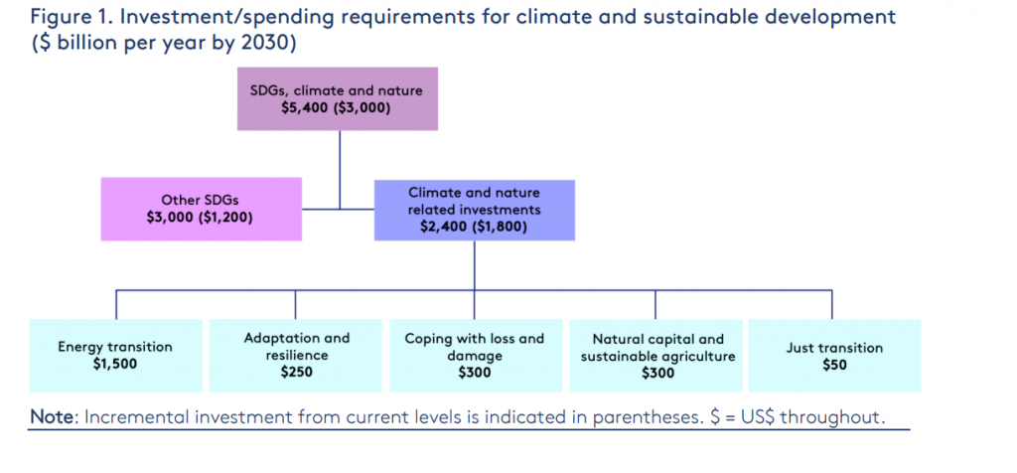

Slide 21
